Slide 1
KnoWhere
An App for Automatically Profiling your Commute using Smart Phone Sensor Data

Slide 2
Commutes are Bad for you!
Higher Blood Sugar
Higher Cholesterol
Higher Depression Risk
Higher Anxiety
High Blood Pressure
Back Aches
Source: http://time.com/9912/10-things-your-commute-does-to-your-body/

Slide 3

_{Where do I go?}
What do I do?

Slide 4
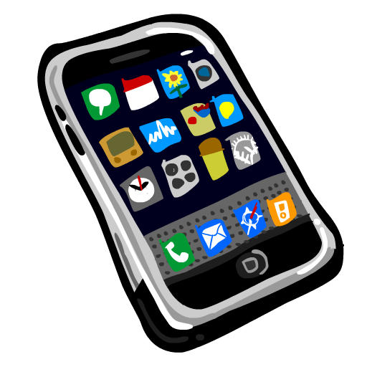



Adding Data is a Drag

Slide 5



The Front End
Turn meaningful analysis into appealing, interpretable visualizations

Slide 6
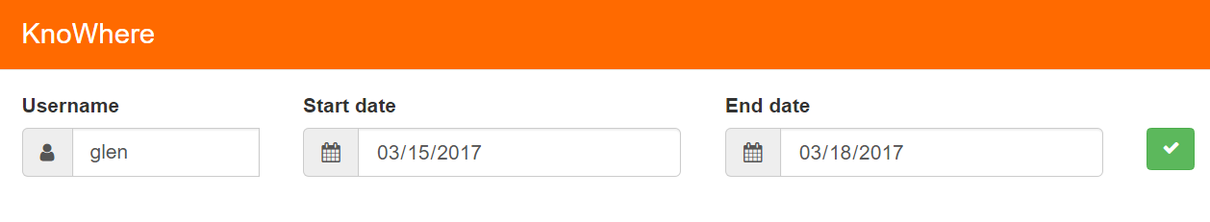
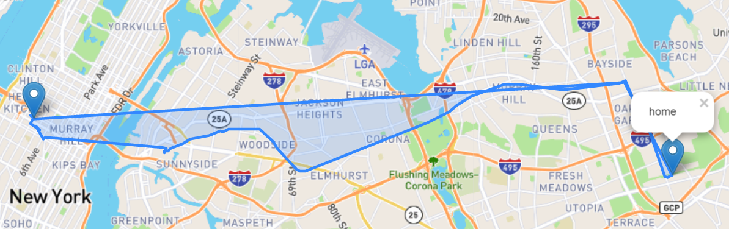
The Front End
Plot the user’s coordinates for the last day in their chosen date range

Slide 7
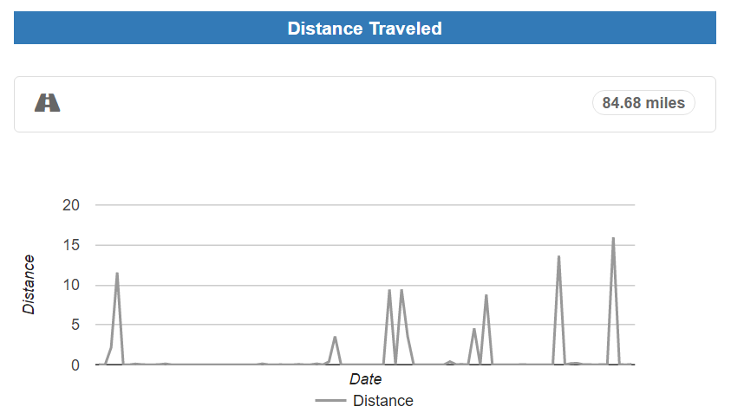
The Front End
Total distance traveled with hourly plots for a date range

Slide 8
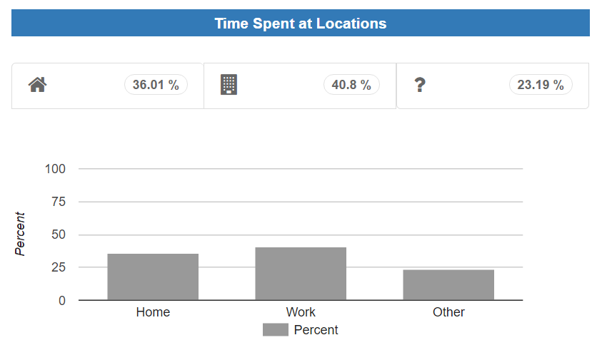
The Front End
Percent of time spent at certain locations for chosen date range

Slide 9
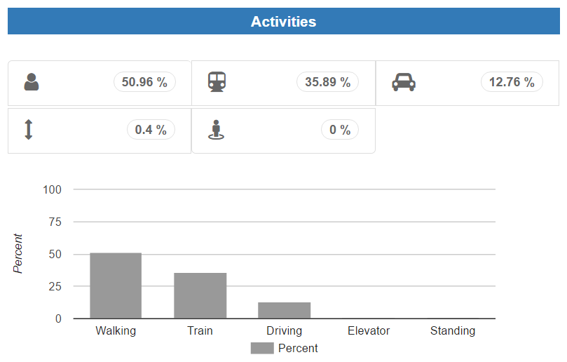
The Front End
Percent of time spent on activities

Slide 10
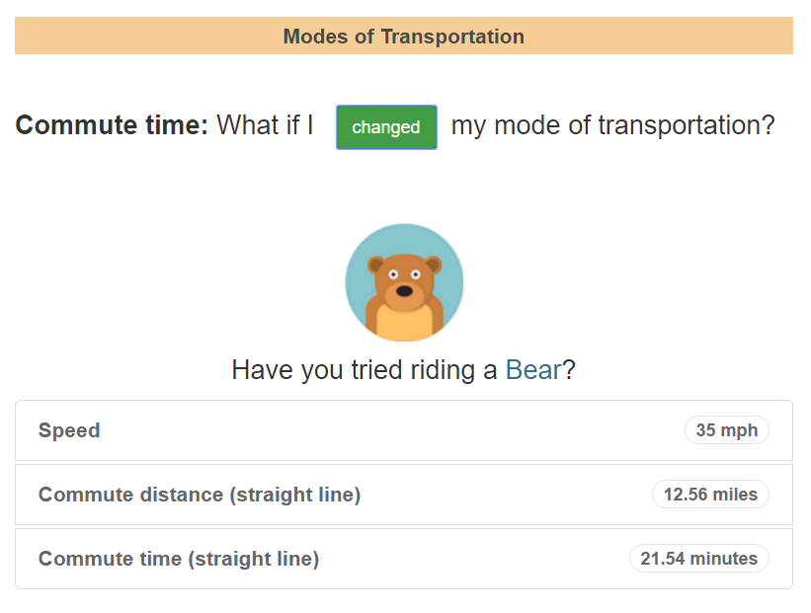
The Front End
Have a little fun!

Slide 11


The Database

Slide 12
MongoDB Collection Example
_id: ObjectId(...),
user_id: ObjectId(...),
timestamp: ISODate(...),
Data: [
Microphone Left Channel Level : ...,
Microphone Right Channel Level : ...
],
sensor: Microphone,
commute: True
iPhone

Slide 13

Data Collection from Smart Phones
Gathered for iPhone
Sensor Kinetics Pro for Android
Both apps had significant disadvantages
Inconsistent sensor readings, e.g., 10 Hz really meant 0.2 Hz
Some sensors had significantly more values than others
Some sensors only updated after a large change

Slide 14
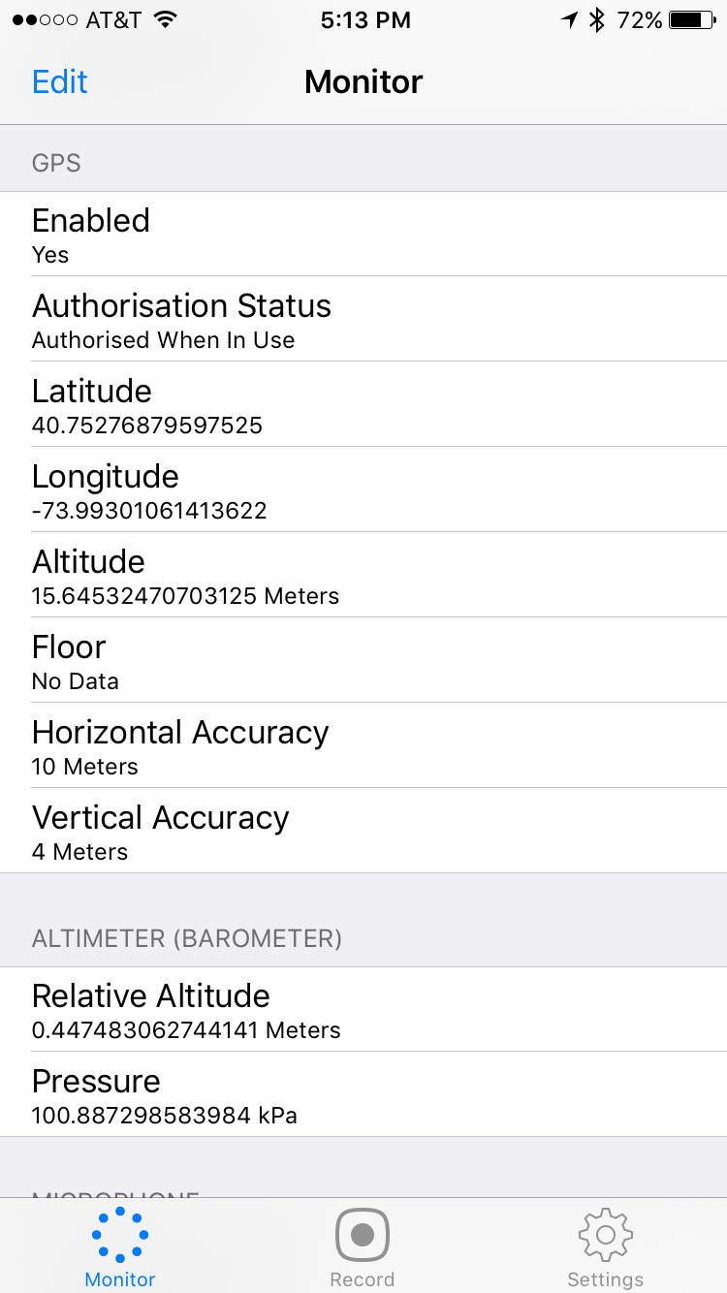
Data Collection from Smart Phones
Gathered
GPS Data
Lat/Long
Altimeter
Accelerometer
Magnetometer
Gyrometer
Attitude
Proximity
Barometer
Clustering
Movement Classification

Slide 15
Clustering
Agglomerative
Must specify number of clusters, affinity, linkage
Number of cluster set to two in our study, Ward Linkage, and Euclidian Distance
Other values performed poorly
DBSCAN
Only need to specify neighborhood size
Forms clusters
Requires more data

Slide 16
Sensor Data - Acceleration

Slide 17
Sensor Data – Altimeter

Slide 18
Sensor Data – Accelerometer

Slide 19
Machine Learning: Predicting Activities During a Commute

Slide 20
Feature Selection: GPS free tracking
Many subways and trains run underground so we use only non-GPS sensor data to for activity tracking

Slide 21
Feature Selection: GPS free tracking
Mean, Std, Max

Slide 22
Into the Woods
Modeling
Gradient Boosting Machine
Neural Network using Keras
Support Vector Machine
Logistic regression, KNN
Random Forest
Academic work supports random forests

Slide 23
Into the Woods: Random Forest Classification SK-OPT

Slide 24
Into the Woods: Random Forest Classification SK-OPT

Slide 25
Quality of the Classifier

Slide 26
Quality of the Classifier
0 = Driving, 1 = Elevator, 2 = Standing, 3 = Train Departing, 4 = Train Stopping, 5 = Walking

Slide 27
Demonstration!

Slide 28
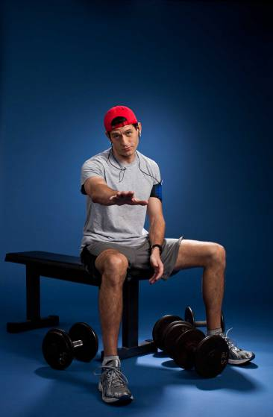
Future Development
Activity Tracking
Commute Suggestions

Slide 29
and of course…

Slide 30
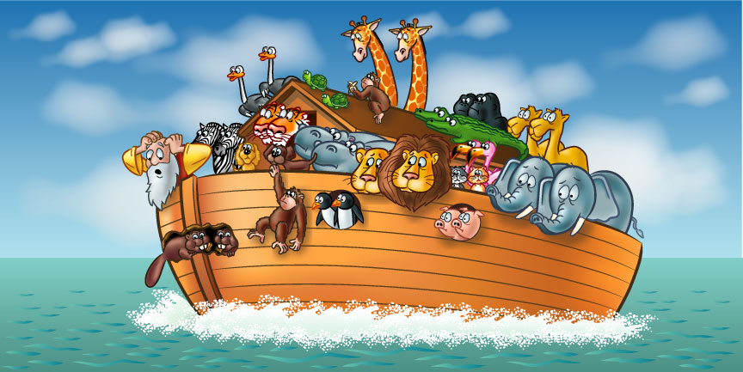
…more animals!

Slide 31
Thank You!

Slide 32
Quality of the Classifier

